Slide 1
Aliant Payment systems, inc.
The best solution for your Independent Sales Organization!

Slide 2
Our Mission Statement
Our Mission is Simple:
Helping Businesses…
Increase revenues and profit
Improve customer loyalty
Reduce operating costs and overhead
...By providing products and services to achieve these goals and gain superb customer service

Slide 3
Benefits
Aliant Payment Systems has been providing electronic payment processing services for large and small merchants throughout the United States since 1996.
APS Inc. is a registered ISO MSP of First Data Corporation.
APS offers complete processing solutions for Retail, Restaurant, Professional Services, Hospitality, e-Commerce, and many other industries.
APS offers a complete line of credit card equipment, software options and web based tools for your processing needs.
Recognized as a leader in Payment Solutions.
Locally based sales representatives available to offer Personalized Customer Service.

Slide 4
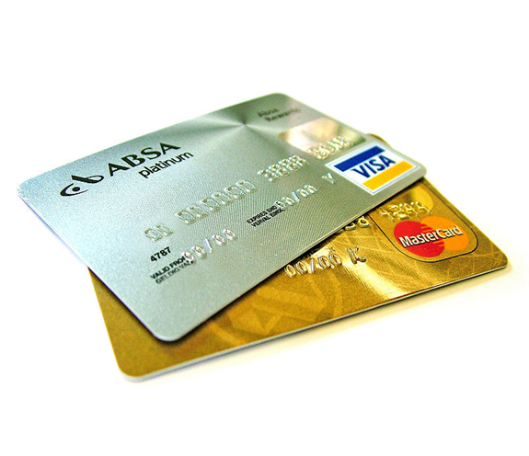
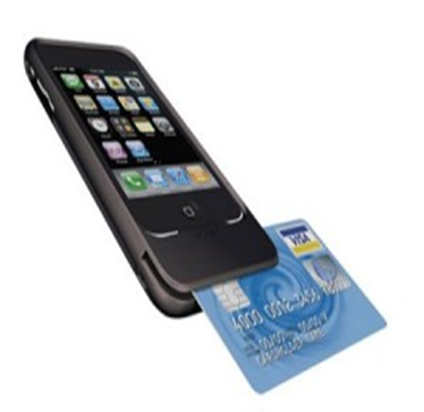
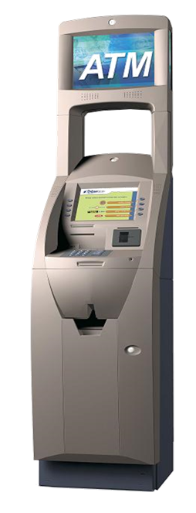
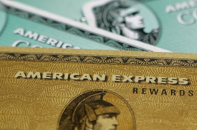
Benefits
Major Credit Card Processing
Debit Card Processing
Check Conversion & Guarantee
American Express OnePoint
ACH Processing
Internet Payment Gateway
Mobile Phone Processing
Wireless Terminal Processing
Electronic Benefits (EBT)
ATM Machines
Gift Card Production & Processing

Slide 5
Benefits
When your Independent Sales Organization teams up with Aliant….
Dedicated Relationship Manager
Aliant Wholesale ISO Approves all applications submitted Liberal Underwriting
All Sales and Marketing Materials Available:
PowerPoint
Logo
Business Cards
Website
Etc…
Complete ISO Back-Office Support:
Direct Customer Service
Data Entry
Electronic Apps
Equipment Deployment
Gateway & Mobile Processing Apps
Equipment Leasing
Online Residual Reporting

Slide 6
Benefits
Aliant helps you Grow your ISO
Sales Techniques
Sales Training
Statement Analysis
Proposal Templates
Marketing Pieces
Strategic Alliances
Sales Webinars
Weekly “IN THE BIZ” Updates on the Merchant Industry
Call Center Management Techniques
Access to Aliant Vendors with Preferred Pricing

Slide 7
Incentives
By Teaming Up with Aliant… WE all Win!!!
Friendly- yet Aggressive Sales Competitions
Trips and Give-aways
Earn Points for Prizes
Call Center Recognition for Monthly/Quarterly Sales

Slide 8
Thank you!

